Slide 1
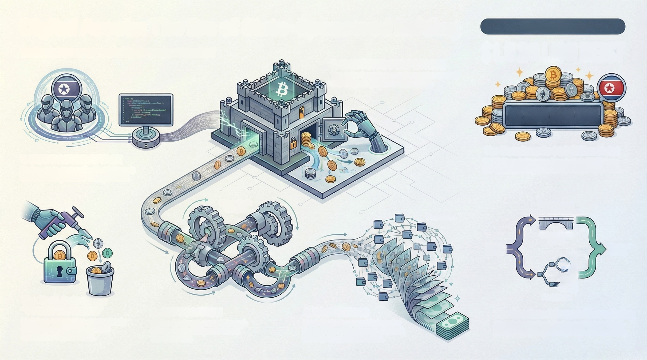
Digital Assets: The Era of State-Sponsored Raiding
The Benchmark:
THE ANATOMY OF A STATE-SPONSORED HEIST
$1.5 BILLION HEIST
2. EXCHANGE COMPROMISE
The actor breaches a major cryptocurrency
exchange to gain access to funds.
$1,500,000,000
The Benchmark: $1.5 Billion Heist
North Korea's Lazarus Group stole $1.5B from
the Bybit exchange in a single 2025 operation.
1. STATE ACTOR ATTACK
Nation-state groups like North Korea's
Lazarus Group initiate the operation.
Cross-Chain
Bridges
Peel Chains &
Cross-Chain Bridges
Peel Chain
Cross-Chain
Bridge
Stolen
Funds
Washed
Funds
0000000
The Tool: Automated
"TOKEN DRAINERS"
Malicious scripts that automatically
empty all assets from a user's
connected crypto wallet.
Peel Chain
3. OBFUSCATION
Stolen funds are moved through
Cross-Chain Bridges to break
the audit trail.
4. LAUNDERING
'Peel Chains' are used to launder
funds through thousands of small,
hard-to-trace transections.
The Evasion: Advanced Laundering
Attackers use Peel Chains and Cross-Chain
Bridges to systematically wash stolen funds.

